Slide 1
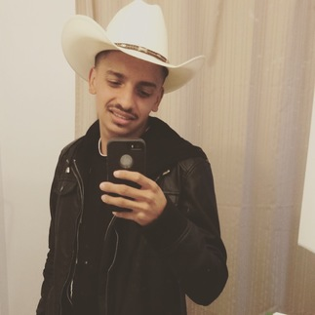
Jose Antonio Frias
Class Of 2016
Exit Interview

Slide 2
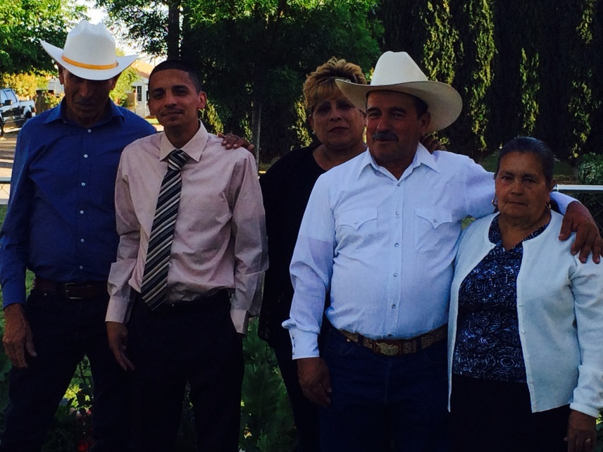
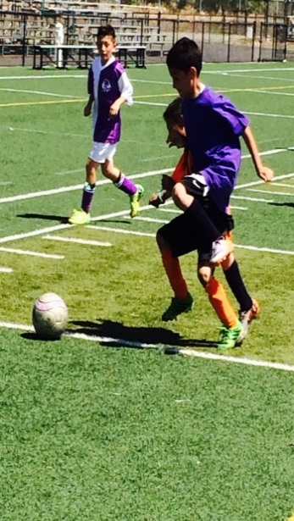
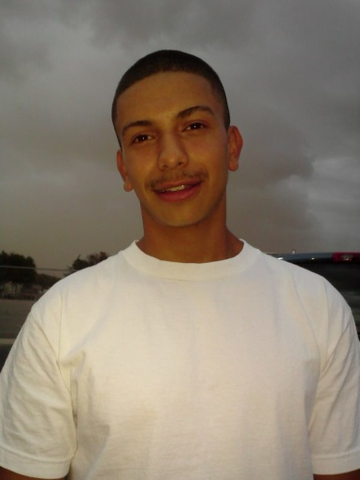
About Me
Born Lindsay
Family is Important
Active
Participated in Multimedia class

Slide 3
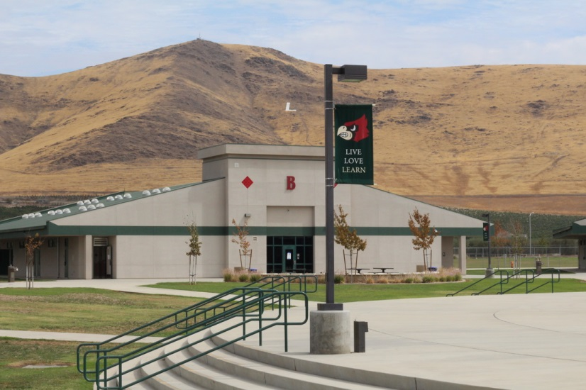
High School Experience
Friends
Schools
Teachers

Slide 4
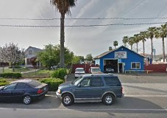
Job Shadow
Enrique Gomez
Mechanic
All About Mechanic

Slide 5
Pathway
Computer Repair Technician
Video Editing/ Multimedia class

Slide 6
Post-High School Plans
COS
Mechanic

